Slide 1
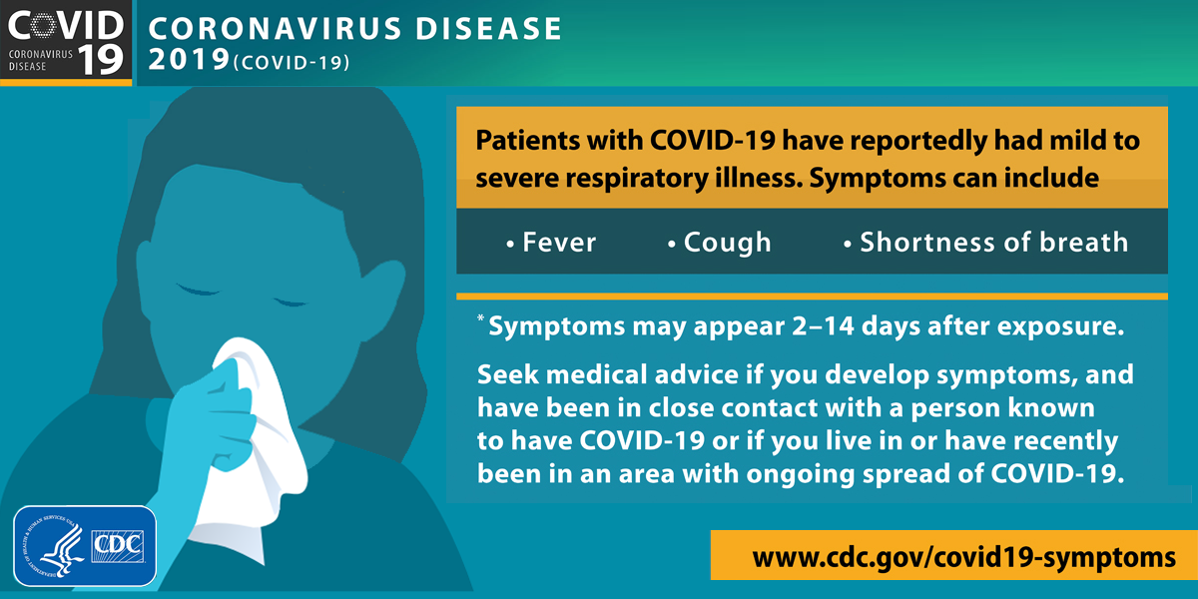
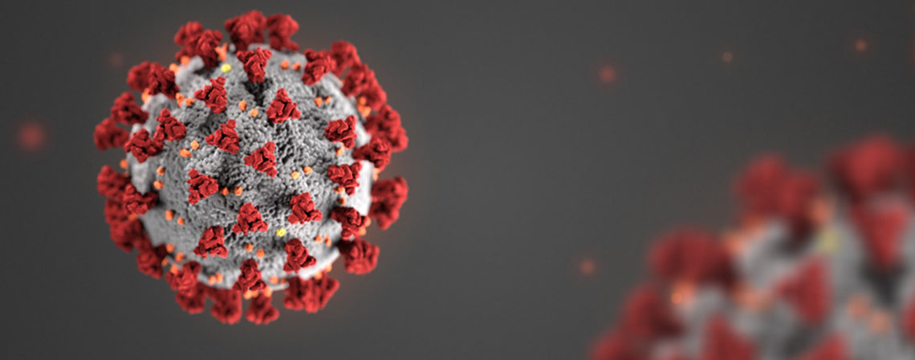
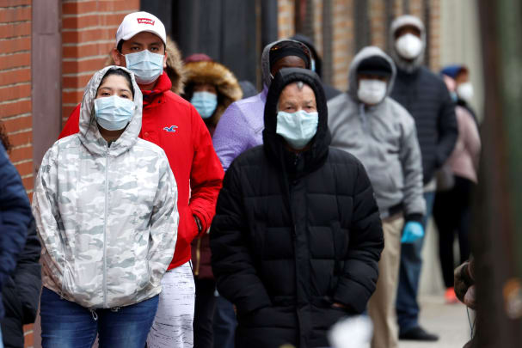
COVID-19 symptom checker
Coders: nida tanuli and brynn powers
We made a COVID-19 symptom-checking chat bot. It will allow users to self identify if they are experiencing symptoms of the virus and if they should seek medical assistance or testing.

